Slide 1
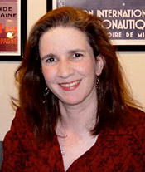
MARY ANN HORN, PhD NSF Funding Opportunities
Thursday, November 17, 2016
11:00 AM – 12:00 PM
Holden Hall 155
Please send a RSVP to Misty

